Slide 1

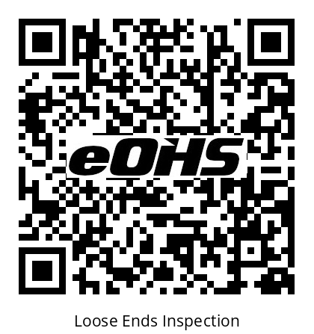
LOOSE ENDS
Equipment Inspection
How to inspect equipment using the eOHS QR code system
NOTE: Only persons with MOL certification on equipment type are permitted to perform inspections
Scan • Check • Sign • Pass / Fail
eohs.tv
1 / 9
Notes:
Welcome. This short session shows how to complete an equipment inspection using the eOHS QR code posted on each piece of Loose Ends equipment.

Slide 2






The Process in 5 Steps
1
2
3
4
5
Scan
Pick
Inspect
Note
Sign
Scan the QR code located on the equipment
Select from the drop-down menu
Complete the inspection referencing the
on board checklist
Document deficiencies
Sign, add your name
SELECT
PASS or FAIL
It only takes a few minutes and must be done before you use the equipment.
eohs.tv
2 / 9
Notes:
Here is the whole process at a glance. Every inspection follows these same five steps.

Slide 3

STEP 1
Scan the QR Code
Locate inspection sticker – every piece of equipment has an eOHS QR code on it.
Open your phone camera – no app or login needed.
Point & tap – hold your camera over the code and tap the link.
The inspection page will open
Code damaged or missing? Notify your supervisor or JHSC
eohs.tv
3 / 9
Notes:
Use the regular camera on your phone. The link opens the eOHS inspection page for Loose Ends automatically — there's nothing to log into.

Slide 4
STEP 2
Pick the Equipment
Select the tab that matches the equipment you are inspecting
Confirm the serial number (SN) matches the unit.
eOHS
Loose Ends Equipment
Pick the Equipment:
SkyJack Construction
SN/123456
Workplace Inspection
SN/Carp Shop and Studio
Example: SkyJack Construction (SN/123456) opens the Forklift Inspection checklist.
eohs.tv
4 / 9
Notes:
Some codes cover more than one item. Always confirm the serial number so the inspection is recorded against the right unit.

Slide 5
STEP 3
Inspect Using the Checklist
Confirm the correct checklist appears on the screen. If checklist is unavailable defer to the onboard checklist located in the document pouch. Complete checklist one item at a time.
Example: Forklift
Before Starting
Safety Features
Running Checks
Fuel / fluid levels
Leaks (fuel, oil, hyd.)
Tires & pressure
Forks & attachments
Capacity plate readable
Seat belt working
Overhead guard
Load backrest
Fire extinguisher full
Lights, horn & wipers
Brakes (service & park)
Steering
Hoist, lower & tilt
Gauges working
Drive controls smooth
Fuel odour or a serious defect? Do NOT start the equipment — FAIL immediately.
eohs.tv
5 / 9
Notes:
The example shown is the forklift checklist. Other equipment will have its own checklist, but the approach is the same: check every item, don't skip any.

Slide 6
STEP 4
Add Your Notes
Use the notes box (“make any relevant notes here”)
to add all observations IE: hours, deficiencies etc
Note small issues also — this will help trap potential issues early. IE ‘battery slow to charge”
Be specific: what, where etc
All good? A short note like “No issues found” or “Hours xxxxhrs”is fine but not necessary unless required by manufacturer or rental company
eOHS
Forklift Inspection
checklist
Left rear tire looks low. Small hydraulic drip under mast.
eohs.tv
6 / 9
Notes:
Notes are what maintenance and supervisors read. Clear, specific notes get problems fixed faster.

Slide 7
STEP 5
Sign, Name & Submit
Sign in the signature box with your finger.
Type your full name.
Select PASS if equipment is safe to use
Select FAIL if equipment is unsafe or needs repair
eOHS
By signing & submitting this form, you agree that you have performed an inspection of this equipment.
Signature:
J. Smith
Your signature confirms YOU did the inspection as per the manufacturers recommendations. Only sign for equipment you checked yourself.
Your Name:
Jane Smith
Pass
Fail
eohs.tv
7 / 9
Notes:
Pass or Fail submits the form — there's no separate submit button. Double-check your notes before tapping.

Slide 8


Pass or Fail: What’s Next?
PASS
FAIL
You’ve determined the equipment inspected is safe to use
Your inspection is automatically saved to the eOHS portal
An email notification is immediately sent to the JHSC for resolution
DO NOT use the equipment
Tag it “Out of Service”
Notify your supervisor
Note: Only a supervisor or the rental company can return a unit to service once FAILED
eohs.tv
8 / 9
Notes:
If in doubt, fail it. It's always better to have a supervisor take a second look than to use unsafe equipment.

Slide 9
Quick Reference
1
Scan the QR code with your phone camera
2
Select equipment from the drop-down menu
3
Inspect equipment referencing the onboard checklist
4
Add notes of any deficiencies
5
Sign, add your name, SELECT PASS or FAIL
Questions?
When in doubt — FAIL it and notify your supervisor.
eohs.tv
9 / 9
Notes:
Recap the five steps and open the floor for questions. Feel free to have attendees scan the sample QR code to try it themselves.

